Slide 1
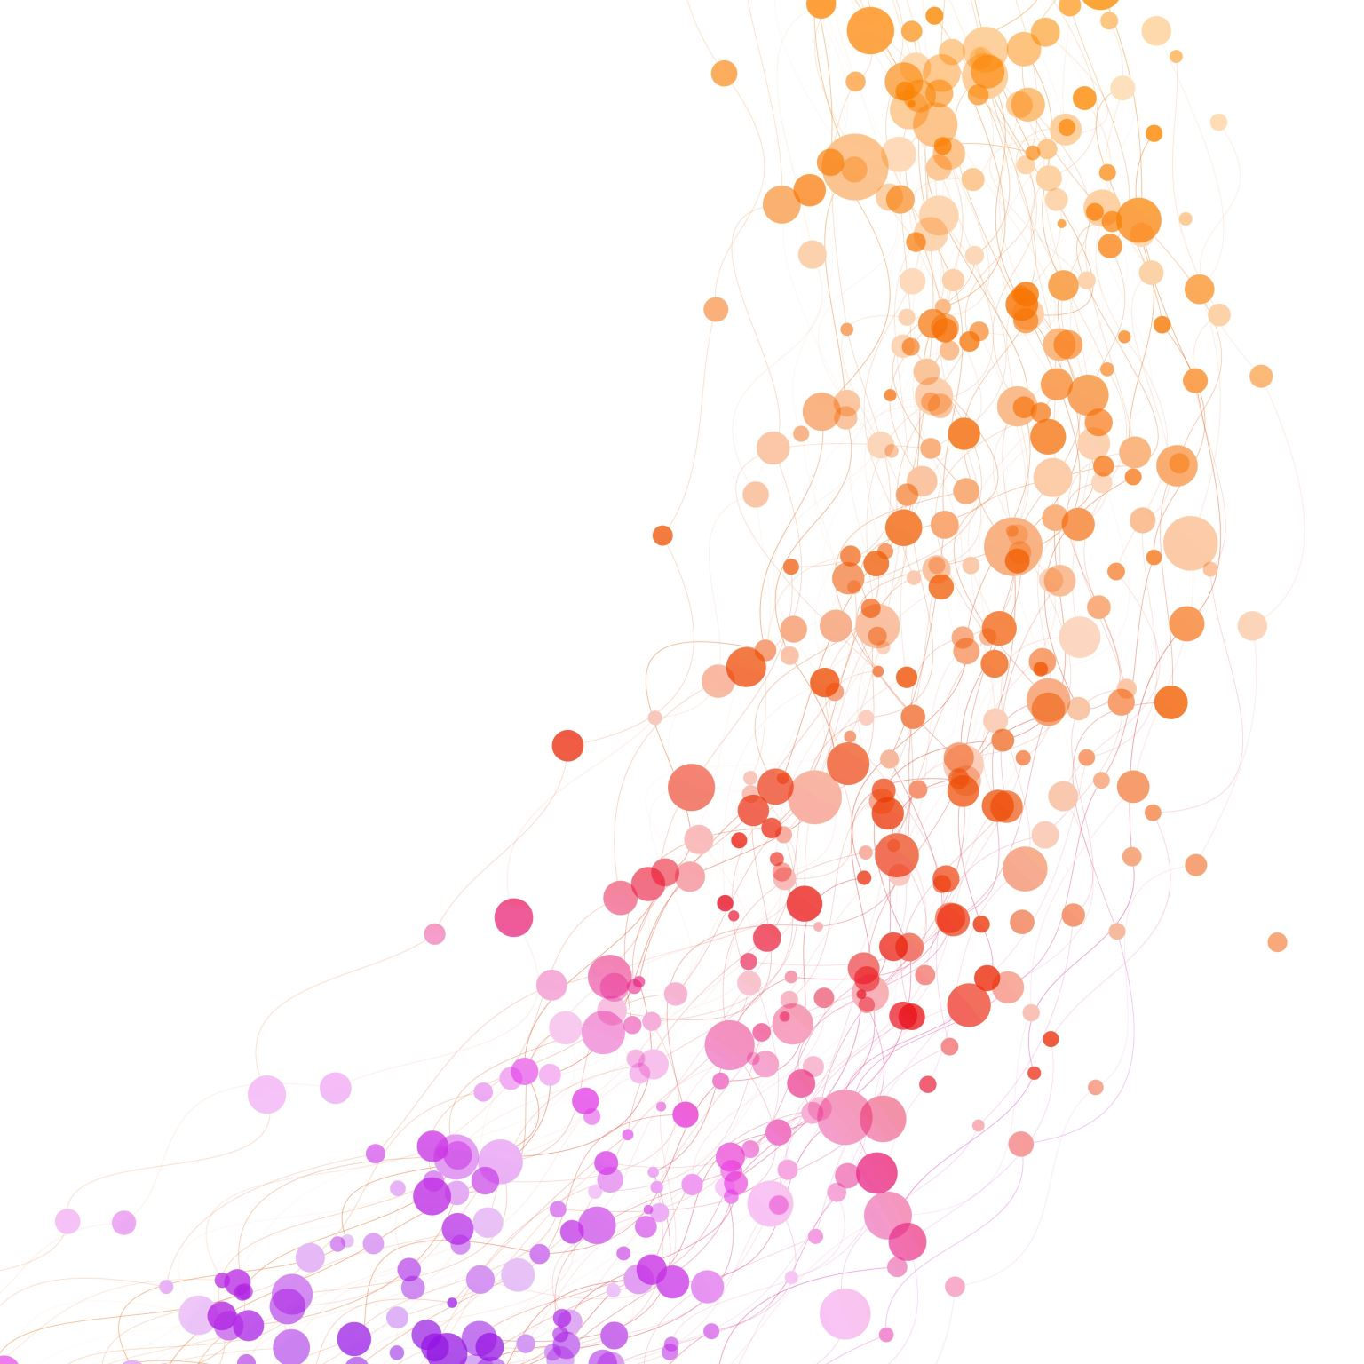
Report – Case Study (Coloured Cubes)
Mohit Mehndiratta
20622275
Master of Data Science
Notes:
Hello Everyone, my name is Mohit.
This is a case study of Coloured Cubes.

Slide 2
Problem Statement
Consider 11 cubes, out of which 3 cubes are red in color, 3 cubes are blue in color, 3 cubes are green in color and 2 cubes are yellow in color. They are stacked randomly on each other on a table and creating a single stack. We must perform 2 actions. One is "put" in which a robot must put a cube one at a time either on the table if there is an empty space and none of the cube placed matches the color of that cube, otherwise put the cube on the same color of the cube. Another action is "remove", in which a robot must remove the cube which is yellow in color. Thus, in the final step we should have 3 stacks of cubes of colors red, blue, and green.
Notes:
the problem statement is

Slide 3
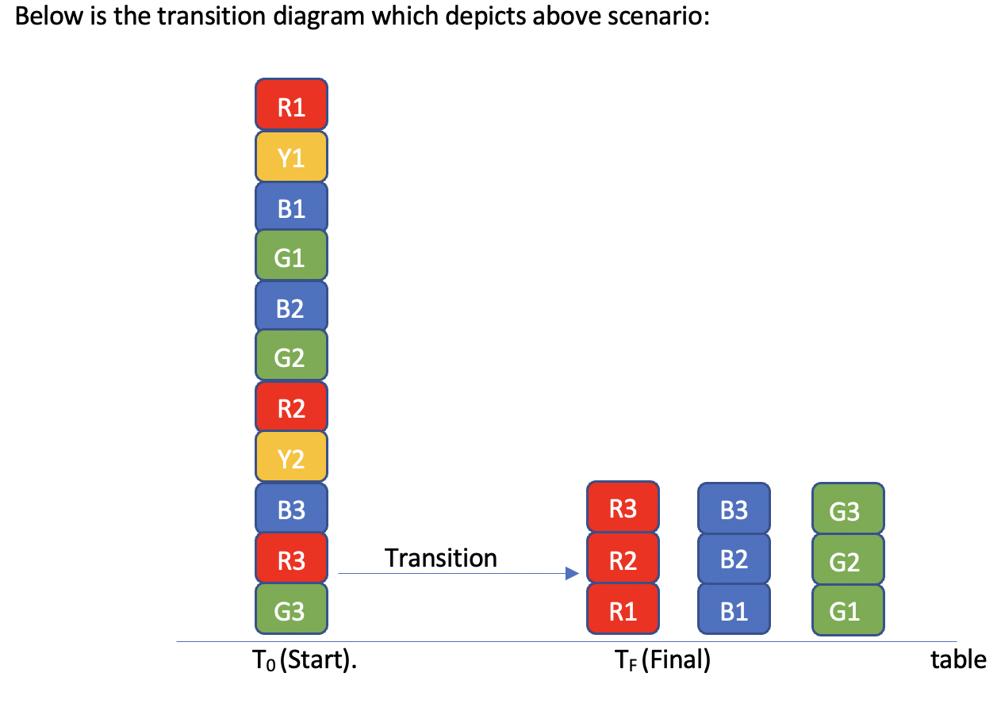
Transition Diagram
Please note that we have denoted colours as names like r1 for first red cube, y1 for first
Yellow cube etc.

Slide 4
Formal Description - Signature
Cube = {r1,y1,b1,g1,b2,g2,r2,y2,b3,r3,g3}
Loc = {r1,y1,b1,g1,b2,g2,r2,y2,b3,r3,g3,t}
Inertial fluent = on(C1,L1)
Defined fluent = above(C1,L1)
Actions = put(C1,L1), remove(C1)
n = 11
Step = 0..n
Notes:
This is the formal description of the signature in which we
have 11 cubes as r1, y1 and so on. and the location as loc
there are a total of 11 steps to reach the final state.

Slide 5
System Description (SD)
Causal Law:
put(C1, L1) causes on(C1, L1)
remove(C1) causes removed(C1)
State Constraints:
-on(C1,L1) if remove(C1) -on(C1,L2) if on(C1,L1), L1 != L2 % A cube cannot be at 2 locations
-on(C2,C) if on(C1,C), C1 != C2 % one cube can be at top of one another
above(C1,L1) if on(C1,L1)
above(C1,L1) if on(C1,C2), on(C2,L1)
Executability Conditions: impossible put(C1,L1) if on(C2,C1), loc(L1) % impossible to move an occupied cube impossible put(C1,C2) if on(C3,C1), on(C2,C4)
impossible put(C1,L1) if on(C1,L2), on(C2,L1), C1 != C2
Notes:
The system description contains causal law, state constraints and executability conditions.
Causal law states that action put C1 at L1 causes C1 on L1
and action remove C1 causes removed C1
State Constraints are:
if a cube C1 is removed, then C1 will not be at any location
Lastly, Executability Conditions are:
it is impossible to move an occupied cube
if there are two cubes that are placed on different cubes.
we cannot put a block on a location which is already occupied.

Slide 6
Encoding SD into ASP
Inertial Rules:
%% Inertia rule 1: Anything that holds at step I, will also hold at step I+1 if no evidence shows its opposite.
holds(F,I+1) :- fluent(inertial,F), holds(F,I), not -holds(F,I+1), I<n.
%% Inertia rule 2: Anything that does not hold at step I, will also not hold at step I+1, as long as no evidence shows its opposite.
-holds(F,I+1) :- fluent(inertial,F), -holds(F,I), not holds(F,I+1), I<n.
Signature | Values
Relations/Predicates | holds, occurs, removed, fluent
Functions/action | put, on, above, remove
Objects | cube, loc
Notes:
Now, we have translated the system description to ASP Program.
the relationship or predicates are holds, occurs, removed and fluent
functions or actions are put on above and remove.
and the objects are cube and locations.
Apart from encoding System Description, we need to implement these inertial rules.
Inertial rule 1 says that

Slide 7
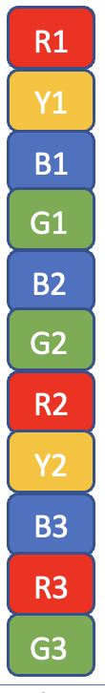
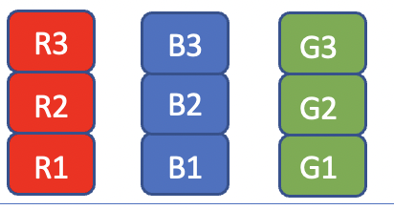
Initial State vs Final State
Initial State
final state
%% Initial Configuration holds(on(g3,t), 0).
holds(on(r3,g3), 0).
holds(on(b3,r3), 0).
holds(on(y2,b3), 0).
holds(on(r2,y2), 0).
holds(on(g2,r2), 0).
holds(on(b2,g2), 0).
holds(on(g1,b2), 0).
holds(on(b1,g1), 0).
holds(on(y1,b1), 0).
holds(on(r1,y1), 0).
%% Encoding action
occurs(put(r1,t),0).
occurs(remove(y1),1).
occurs(put(b1,t),2).
occurs(put(g1,t),3).
occurs(put(b2,b1),4).
occurs(put(g2,g1),5).
occurs(put(r2,r1),6).
occurs(remove(y2),7).
occurs(put(b3,b2),8).
occurs(put(r3,r2),9).
occurs(put(g3,g2),10).

Slide 8
Query Evaluation.. (I)
Show all the outcomes of holds for each transition
The output contains information like:
holds(on(r3,r2),11), holds(on(g3,g2),11), holds(on(b3,b2),11), holds(on(r2,r1),11), holds(on(g2,g1),11), holds(on(b2,b1),11), holds(on(r1,t),11), holds(on(g1,t),11), holds(on(b1,t),11).
This exactly, is the 11th and final stage of our desired outcome.

Slide 9
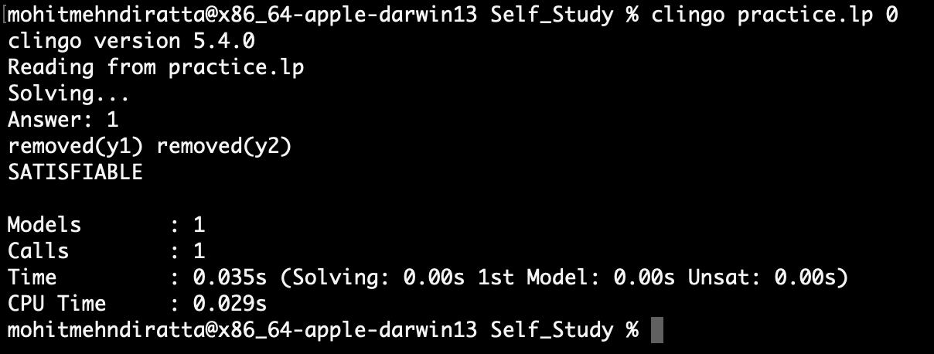
Query Evaluation.. (II)
Show the cubes which are removed:
Output:
From this, we can see that both the yellow cubes are removed.

Slide 10
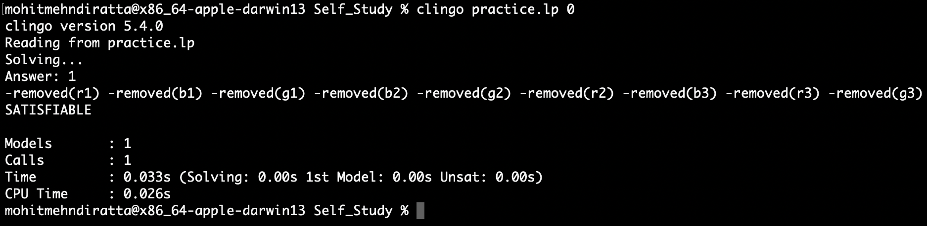
Query Evaluation.. (III)
Show the cubes which are not removed:
Output:
We can see that all cubes except yellow ones are not removed.

Slide 11
Thank You.

